Slide 1
Semiconductor Memory
Lecture 11

Slide 2
The memory of a computer system normally consists of one or more PC boards that are connected to the system bus.
On each board is a module that is addressed by the high-order bits on the address bus.
Most systems include both ROM and RAM modules.
The memory consists primarily of an interface and an array of memory IC devices, each of which contains an array of memory cells with each cell being the circuitry needed to store 1 bit.

Slide 3
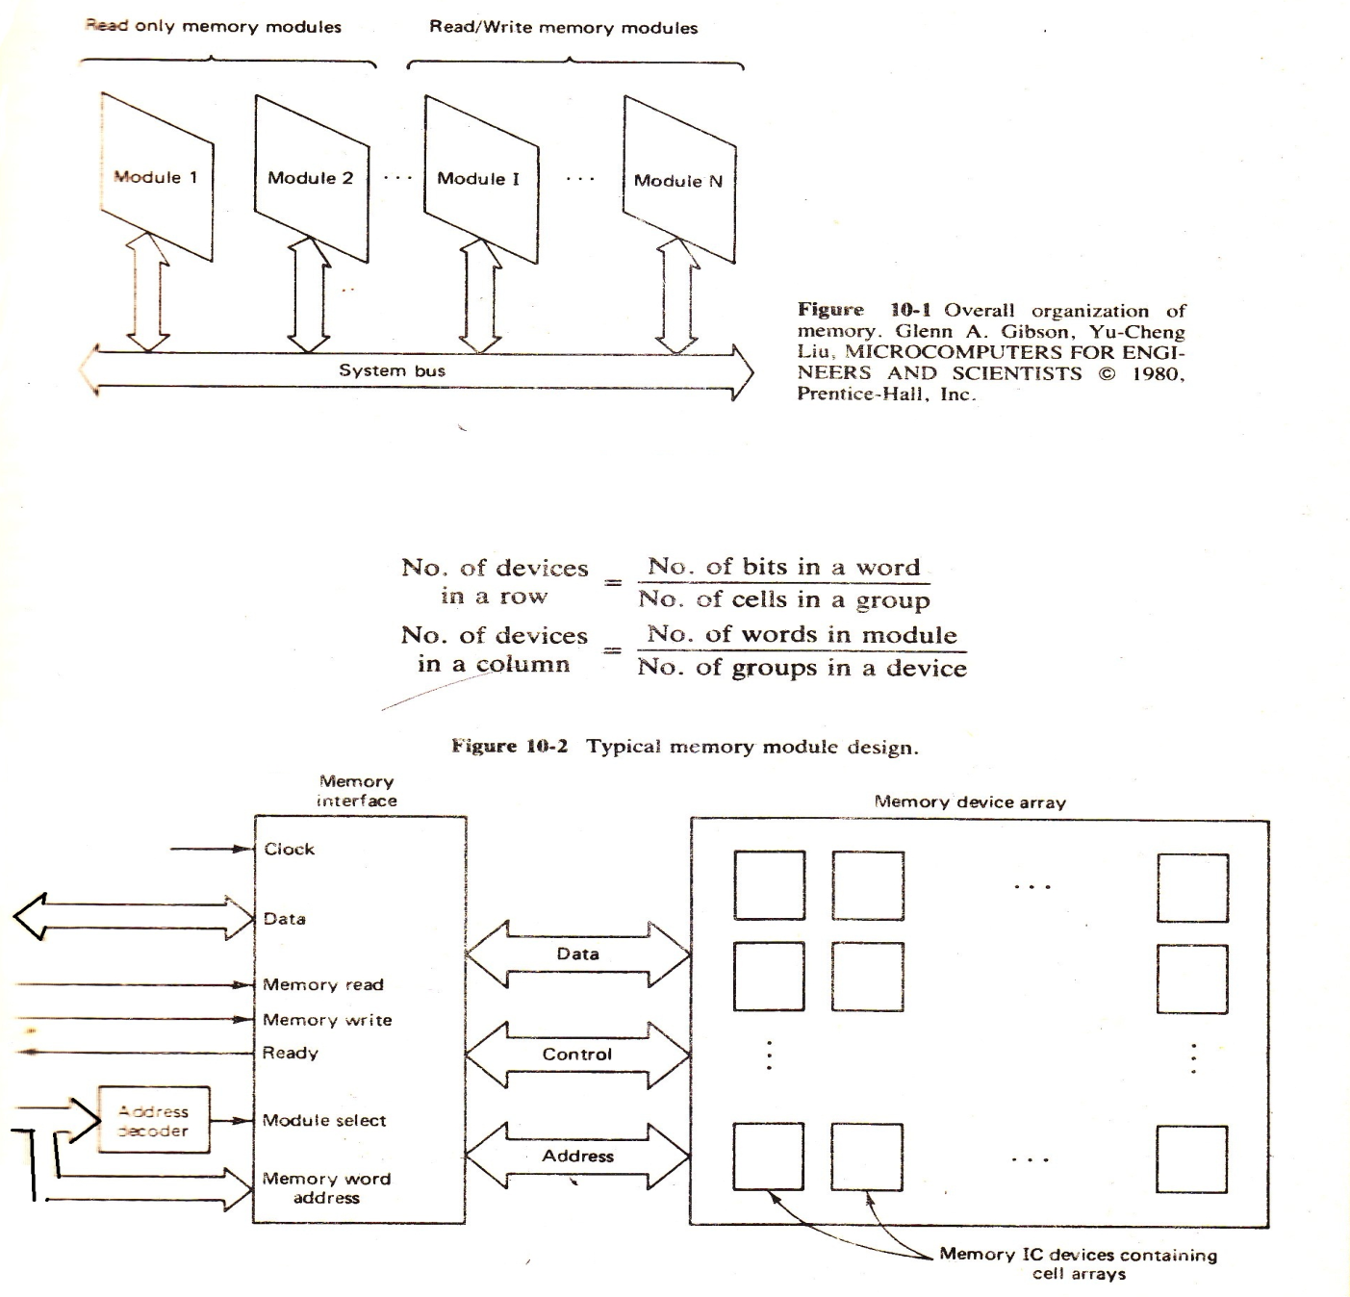

Slide 4
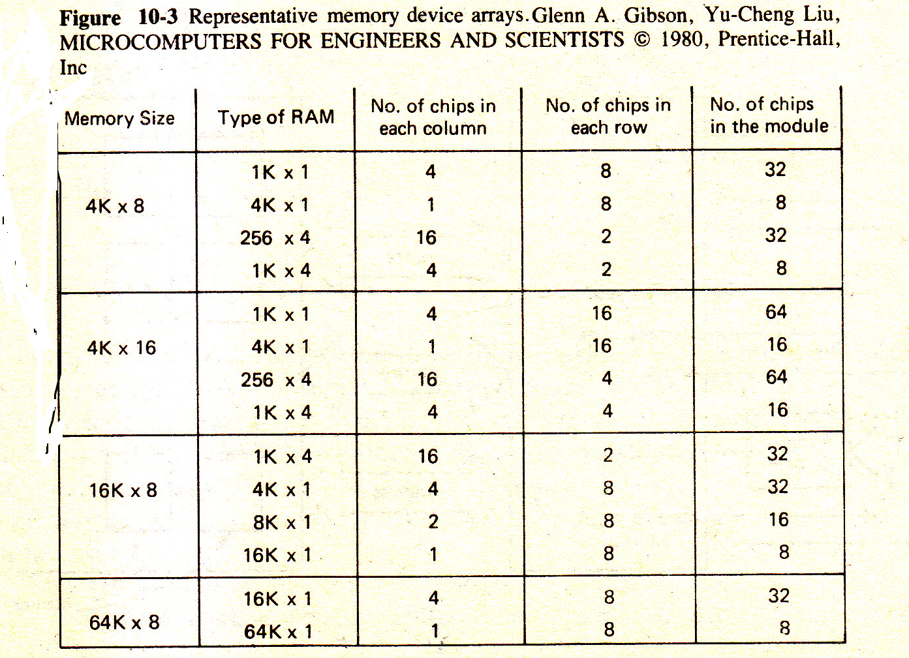
A memory device is said to be an M x N device if it contains M groups with each group consisting of N cells.
Similarly, a K x L module is one that consists of K words, each having L bits.

Slide 5
The principal criteria involved in designing a memory are:
1. Cost.
2. Capacity.
3. Speed.
4. Power consumption.
5. Reliability.
6. Volatility and access capability.

Slide 6
The cost of a memory module normally consists of two components, one which is independent of the size of the module and is called overhead, and one which is proportional to the size and is called the incremental cost.
The overhead cost is due primarily to the support and interface electronics in the module, and the incremental cost is most-closely related to the cost of the memory devices.
Both overhead and incremental costs are dependent on the number of pin connections and the complexity of the board design.
Therefore, memory devices with large bit capacities and that require few supporting chips ordinarily have a cost advantage.
Because the overhead tends to be the same regardless of the capacity of the module but must be included for each module, it is generally better to fulfill the overall memory capacity requirement using as few modules as possible.
Another factor which enters into the overhead is the cost of the power supply.

Slide 7
The fewer the number of supply voltages that are required, the less complicated-the power supply and board design.
The speed of a memory is gauged by its access time, which is defined as the time delay between the receipt of a stable address input and the data output.
This time depends on many factors and is even related to the bit capacity of the memory devices.
High-speed transistors tend to require more chip space so that fewer cells can be included on each chip.
Also, high-speed devices, which are normally made using a bipolar technology, are more expensive and consume more power.
Power consumption can be very important in systems that must sometimes be powered by batteries or solar cells (e.g., space vehicles).
The technology used in constructing the IC determines the power required for each cell.
The technology most often used in low-power applications is the complementary metal-oxide semi-conductor (CMOS) technology.

Slide 8
The main disadvantage associated with CMOS is that fair amount of chip space is needed for each cell; thus the capacity of each device is reduced.
Unfortunately, power consumption and speed tend to be pro-portional and it is difficult and expensive to achieve both low power and high speed.
The technology that has been found to be a good compromise of speed, power consumption, capacity per device, and cost is the high-density MOS (HMOS)technology.
Because the reliability of an IC is high once it has been thoroughly tested, the reliability of a module is strongly related to the number of solder connections and board complexity. Therefore, reliability increases as the total pin count de-creases, thus supplying an additional incentive to minimize the number of memory and supporting devices in a module.

Slide 9
Unless an application requires nonvolatility there is no reason to provide it. If nonvolatile RAM is needed, then either core memory must be used or backup power must be available so that the volatile semiconductor memory can be maintained in a powered-up state.
Nonvolatility and access capability are pretty much dictated by the application.
ROM is generally used whenever possible because it is less expensive, nonvolatile, more reliable, and impervious to noise, and its simple construction lends itself to high cell density.

Slide 10
1. Static RAM (SRAM)
Essentially uses flip-flops to store charge (transistor circuit)
As long as power is present, transistors do not lose charge (no refresh)
Very fast (no sense circuitry to drive nor charge depletion)
Complex construction
Large bit circuit
Expensive
Used for Cache RAM because of speed and no need for large volume

Slide 11
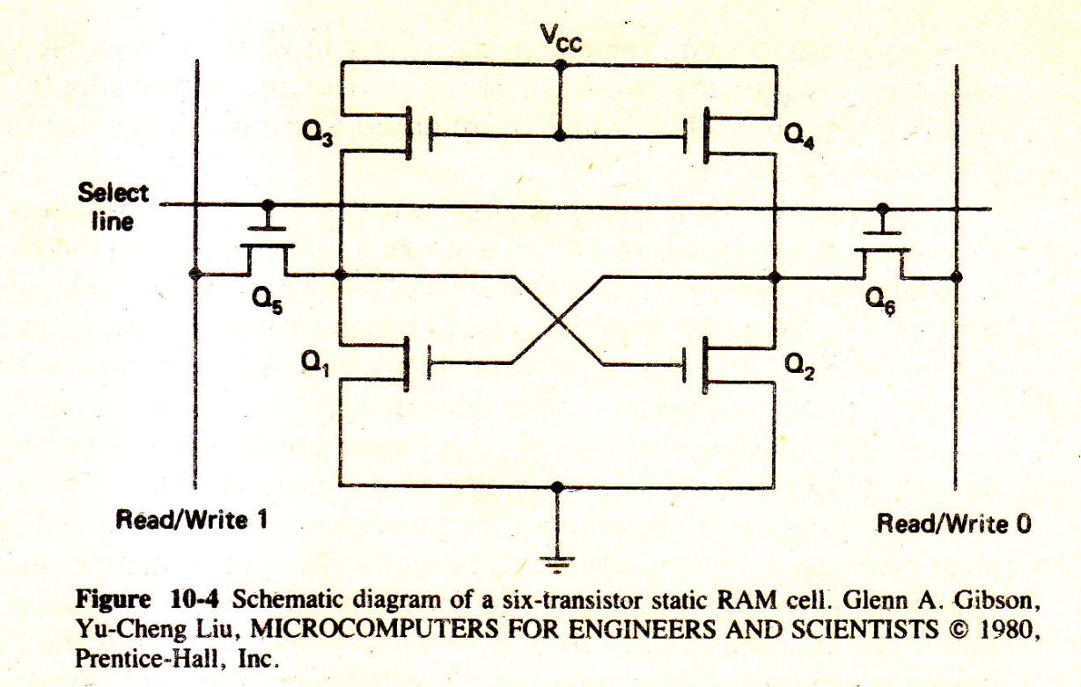
STATIC RAM DEVICES
For static memory devices, a cell is commonly implemented using six MOS transistors.
Information is stored according to the states of transistors Q1 and Q2. This cross-coupled transistor pair is such that when one transistor is on, the other is off, and vice versa.
A 1 is assigned to the state that exists when Q2 is on and Q1 is off, and a 0 is assigned to the opposite state.
The transistors Q3 and Q4 serve as resistors and Q5 and Q6 act as enable gates.

Slide 12
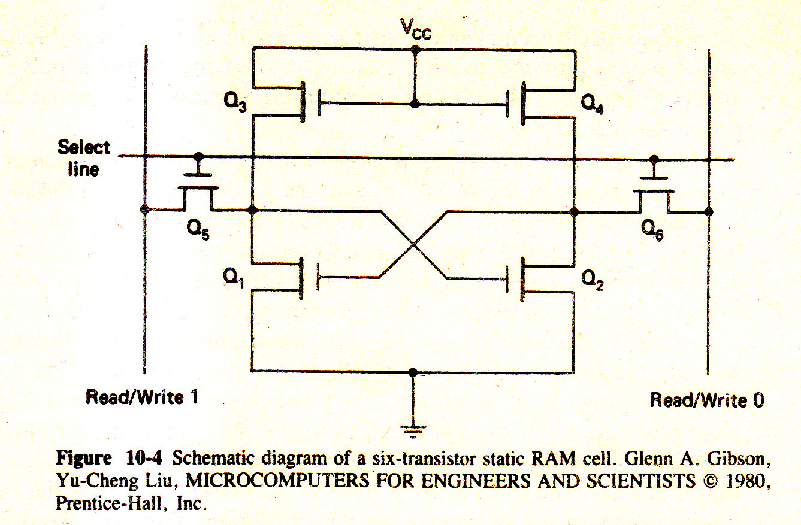
During a write operation, first the cell is selected by raising the voltage level on the select line. When this is done, transistors Q5 and Q6 act as short circuits, so that the Read/Write 1 line is applied to the gate of Q2 and the Read/Write 0 line is applied to the gate of Q1.
To write a 1 into the cell a 1 is placed on Read/Write 1 and a 0 is placed on Read/Write 0 .
This causes Q2 to be turned on and Q1 to be turned off.
On the other hand, if a 0 is to be written into the cell, a 1 is placed on Read/Write 0 and a 0 is placed on Read/Write 1.

Slide 13
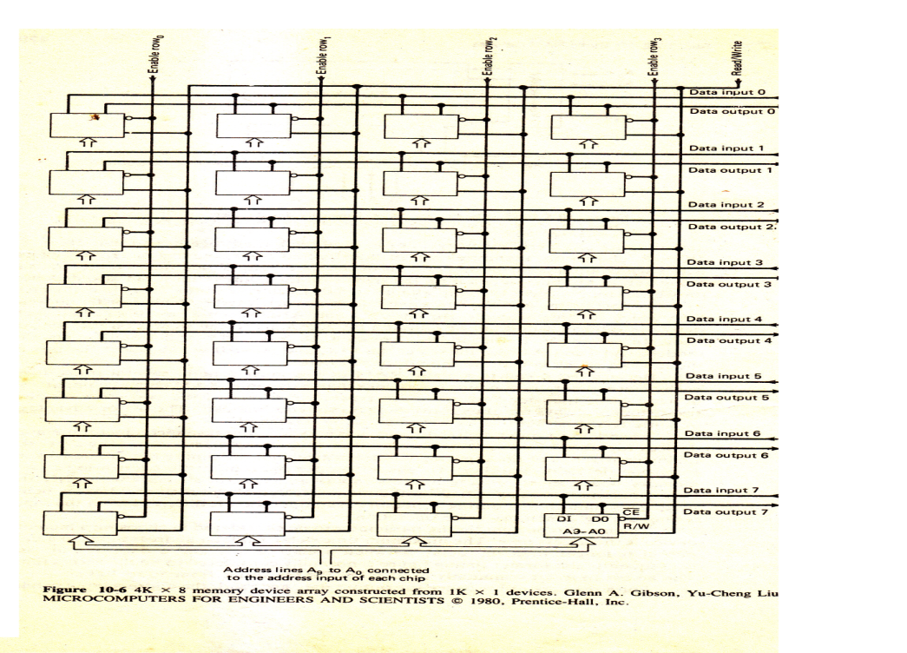
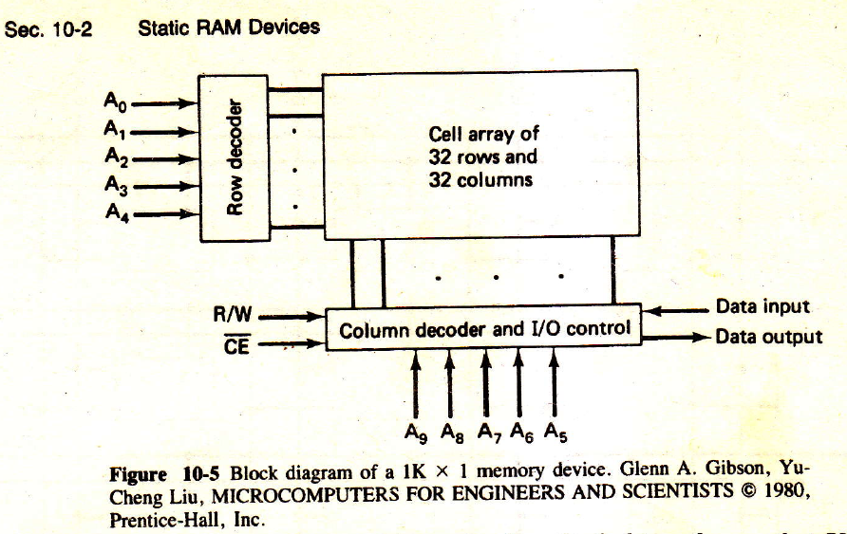
In either case, once they are set the states of Q1 and Q2 will remain unchanged until the next write operation.
The cell can be read simply by applying a voltage to the select line. When this is done, the state of Q1, is applied to Read/Write 0 and the state of Q2 is applied to Read/Write 1.
A 4K x 8 memory device array which is constructed from 1K x 1 devices
is shown in the following figure.
If a chip is enabled, a read or write operation will proceed as specified by R/W control input.
The read/write signal will not be recognized and the output is forced into a high-impedance state.

Slide 14
This allows the data outputs of several memory chips to be directly tied together so that 2K x 8, 4K x 8; and so on, memories can be constructed from columns of 1K X 1 chips with each column contributing one bit of the data byte.
When this is done, the bit being output not only depends on the signals on the address lines, but also depends on receive the chip enable signal.
Each row in the array is connected to a row enable line and the row enable lines are activated by higher-order address bits which for this example are bits A11 and A10.
When a row is selected each device in the row will input or output a bit according to the signals on the A9-A0 lines.

Slide 15


Slide 16
Because each cell in a static RAM device must contain several transistors, each device generally contains fewer cells than a dynamic RAM chip of comparable design.
Also, they tend to use more power since one of the two cross-coupled transistors is always on, thus consuming power continuously.
The major advantage of static RAM is that it does not need to be refreshed.
The most important timing parameter to be considered in choosing a memory device is the access time.
The maximum time delay from an address input to a data output is longer than the delay between a chip enable and a data output, and consequently the former timing figure is normally considered to be the access time.
The access time for commonly used MOS RAMs varies from 50 to 500 ns.
For a read operation, once the output data are valid, the address input cannot be changed immediately to start another read operation.
This is because the device needs a certain amount of time, called read recovery time, to complete its internal ope€rations before the next memory operation

Slide 17
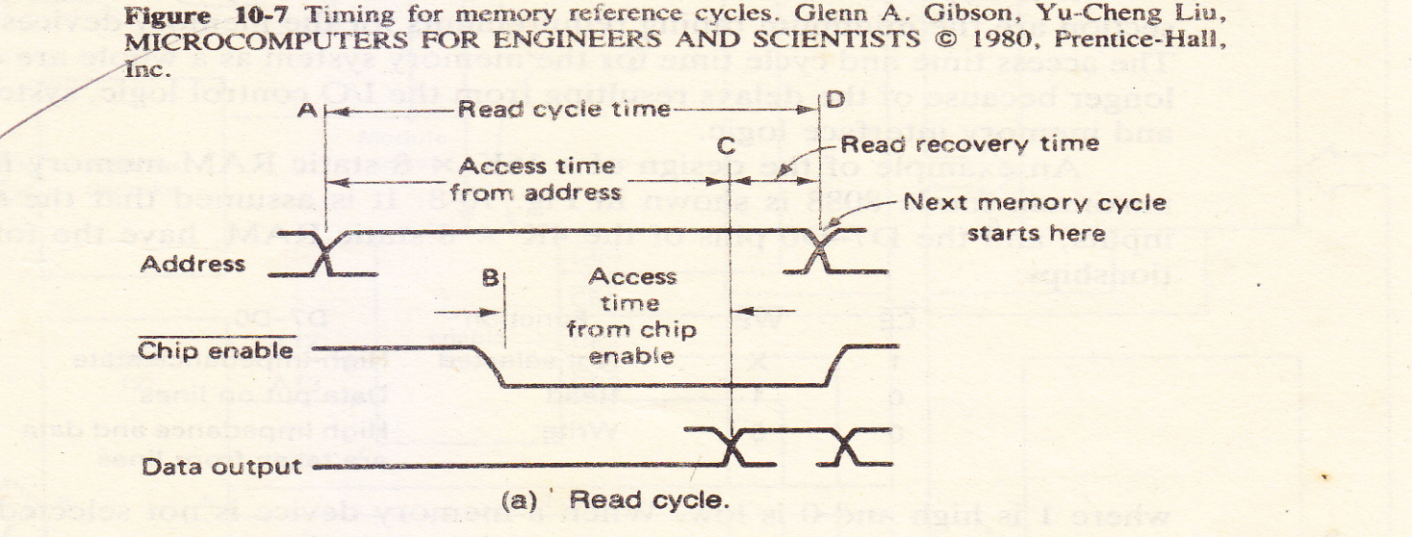
The sum of the access time and read recovery time is the memory read cycle time.
This is the time needed between the start of a read operation and the start of the next memory cycle.
The memory write cycle time can be similarly defined and may be different from the read cycle time.
Figure 10-7(a) illustrates the timing of a-memory read cycle.
The address is applied at point A, which is the beginning of the read cycle, and must be held stable during the entire cycle.
In order to reduce the aceess time, the chip enable Input should be applied before point B .
The data output becomes valid after point C and remains valid as long as the address and chip enable inputs hold. The R/W control input is not shown in the timing diagram for the read cycle, but should remain high throughout the entire cycle.

Slide 18
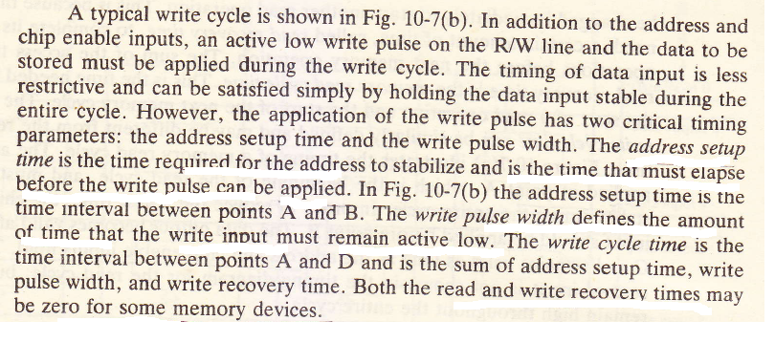
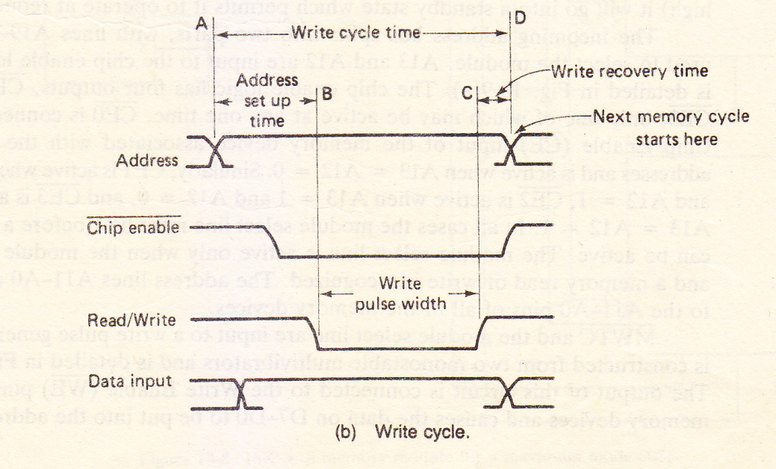

Slide 19
2. Dynamic RAM (DRAM)
Bits stored as charge in capacitors
Simpler construction
Smaller per bit
Less expensive
Slower than SRAM
Typical application is main memory
Essentially analogue -- level of charge determines value

Slide 20
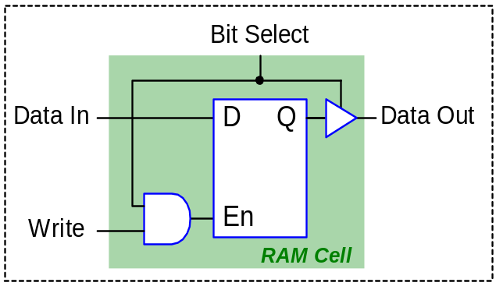
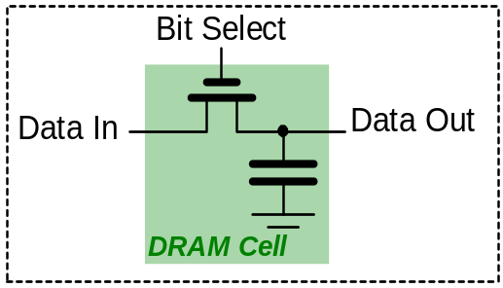
RAM Cells
Static RAM (SRAM):
The basic element of a static RAM cell is the D-Latch.
Data remains stored in the cell until it is intentionally modified.
SRAM is fast (Access time: 1ns).
SRAM needs more space on the semiconductor chip than DRAM.
  SRAM more expensive than DRAM
  SRAM needs more space than DRAM
SRAM consumes power only when accessed.
SRAM is used as a Cache
Dynamic RAM (DRAM):
DRAM stores data in the form of electric charges in capacitors.
Charges leak out, thus need to refresh data every few ms.
DRAM is slow (Access time: 60ns).
DRAM needs less space on the semiconductor chip than SRAM.
  DRAM less expensive than SRAM
  DRAM needs less space than SRAM
DRAM needs to be refreshed
DRAM is used as the main memory
ACOE255

Slide 21
DYNAMIC RAM DEVICES
Just like static RAMs, the memory on a dynamic memory chip is organized in a matrix formed by rows and columns of memory cells.
The simplest type of dynamic RAM cell contains only one transistor and one capacitor, as shown in Fig. 10-10.
Whether a 1 or 0 is contained in a cell is determined by whether or not there is a charge on the capacitor.
During a read operation, one of the row select lines is brought high by decoding the row address (low-order address bits).
The activated row select line turns on the switch transistors e for all cells in the selected row.
This causes the refresh amplifier associated with each column to sense the voltage level on the corresponding capacitor and interpret it as a 0 or a 1.
The column address (high-order address bits) enables one cell in the selected row for the output.

Slide 22
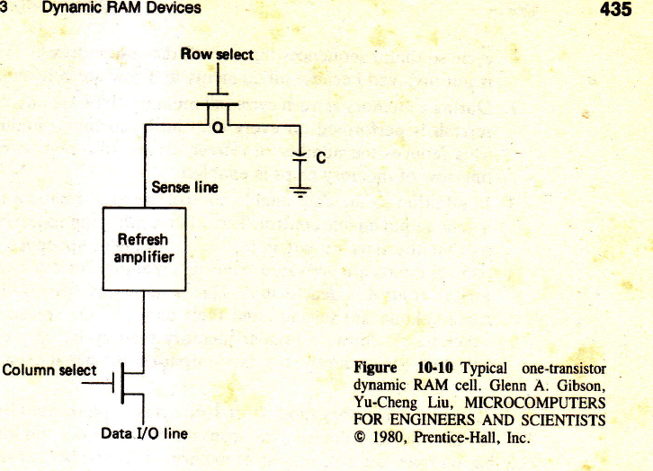
During this process, the capacitors in an entire row are disturbed.
In order to retain the stored information, the same row of cells is rewritten by the refresh amplifiers.
A write operation is done similarly except that the data input is stored in the
selected cell while the other cells in the same row are simply refreshed.

Slide 23
As a result of the storage discharge through pn –junction leakage current,
dynamic memory cells must be repeatedly read and restored.
This process is called memory refresh.
The storage discharge rate increases as the operating temperature
rises, and the necessary time interval between refreshes ranges from 1 to 100 ms.
When operating at 70c, the typical refresh time interval is 2 ms.
Although a row of cells is refreshed during a read or write, the randomness of memory references cannot guarantee that every word in a memory module is refreshed within the 2-ms time limit.

